Slide 1



Transitioning to Secondary School Week 4

Slide 2
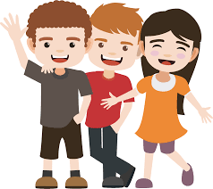
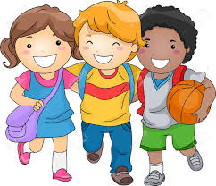
Friendship and People
Most children in your class will feel comfortable and happy because they know everyone very well and feel like they belong.
Just having one teacher can make you feel safe too or being with the same classmates everyday (well up until March that was!)

Slide 3

Friendship and People
Going to secondary school can be different because you won’t know everyone and it may take a bit of time to feel like you ‘belong’ in your new class.
The important thing to remember is that EVERYONE will feel the same way and that you’re not alone.

Slide 4
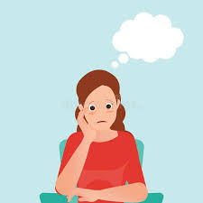
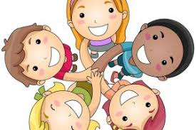
Friendship and People
It’s actually a good opportunity to make new friends and learn from adults who have specialized in their particular subject (no more ‘we’ll have to Google that one’ from me!)
On your activity sheet fill in three people you are looking forward to meeting.
Underneath fill in someone you’re not sure about meeting and why. Remember these are your own private thoughts but if you have worries it’s always a good idea to talk them over with someone.

Slide 5
Friendship and People
Everyone has strengths and weaknesses.
Some people find it easy to get to the top level on a computer game whilst others never get past level 1.
Some pupils have no problem m drawing amazing life-like pictures whilst others find it difficult to draw a good stick-man.

Slide 6
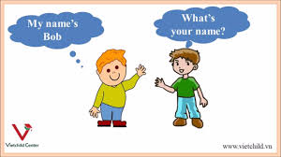
Friendship and People
It’s the same with making friends.
Some pupils love meeting new people, are very chatty and make lots of friends easily.
Others don’t know how to begin to make even one new friend.

Slide 7

Friendship and People
Below are some helpful hints to help you make a new friend. Why don’t you practice with someone at home?
Smile
Tell them your name and ask what they’re called
Find out what they’re interested in
Talk about shared interests- you both might like computers
Ask them if they want to do something at break-time

Slide 8
Friendship and People
On your activity sheet I want you to think about what can you do that will help you make new friends?
I also want you to think of 5 ways that you can tell someone is a good friend.

Slide 9

That’s all for this week
Next week we will be talking about rumours and the similarities between secondary school and primary school.
Have a good week!

